Slide 1
Customer Booking Predictive Modelling
By Adam Meyer

Slide 2
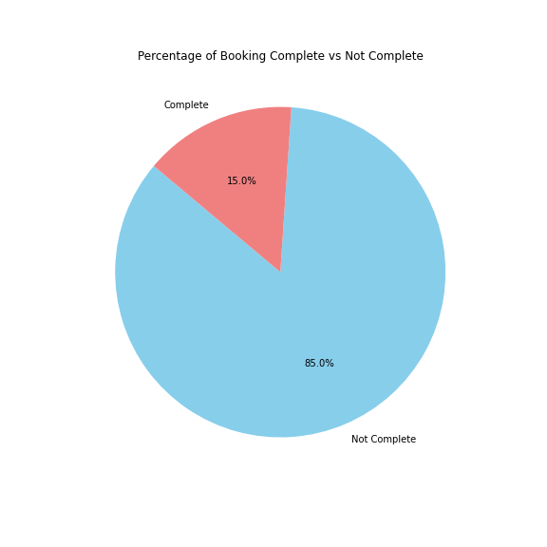
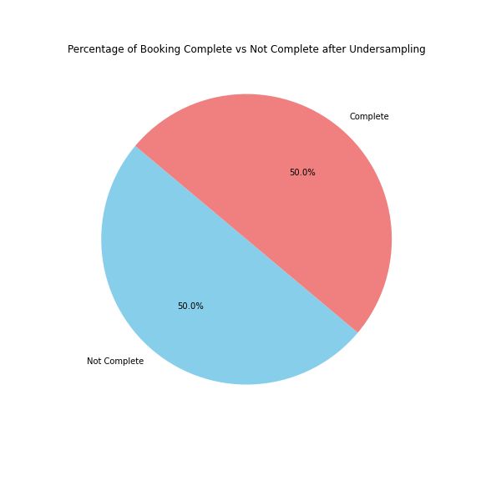
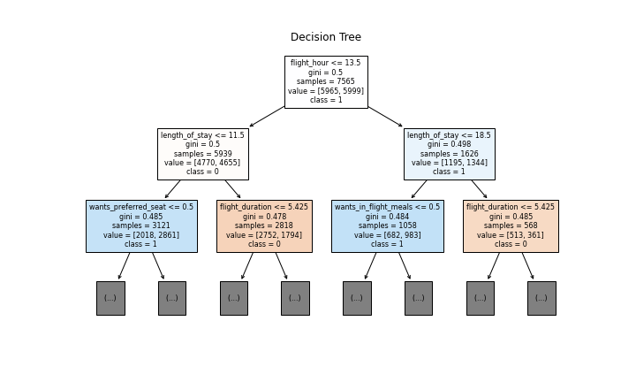
Results
Most of the bookings were not completed making it very biased
Used under sampling method to create an unbiased dataset
Random Forest Created model with an accuracy of 63%
Most important variables are the number of days spent at destination and the hour of flight departure

